Slide 1
Cloud Native Application — Ritu Maheshwari Developer Advocate

Slide 2
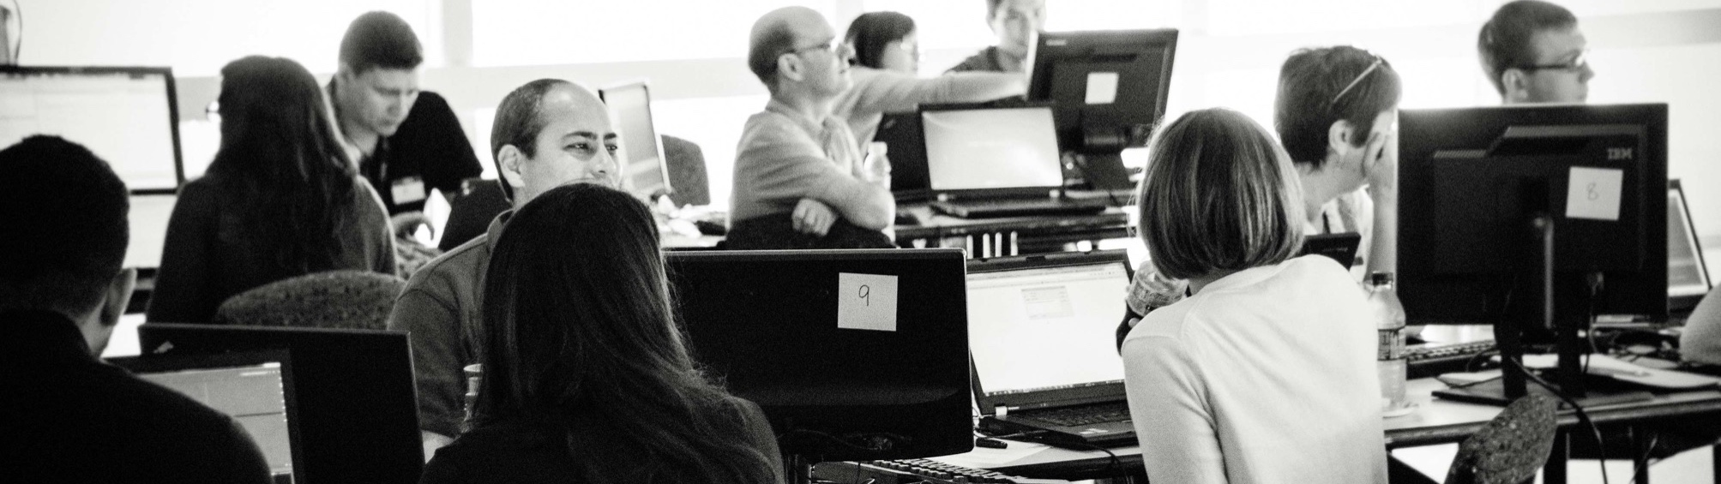
Contents
Quick Recap
Key tenets of Cloud Native Application
Key tenets of a Microservices Architecture
Why Microservices and Cloud Native?
12 Factor Apps

Slide 3
Quick Recap - Last Session
Container: A standard way to package an application and all its dependencies so that it can be moved between environments and run without change.
Docker: Docker is one of the most popular Containerization platforms which allows you to develop, deploy and run application inside containers.
Kubernetes: is a container orchestrator to provision, manage and scale applications.

Slide 4
App Modernization is inevitable

Slide 5
Cloud-native is about how we build and run applications taking full advantage of cloud computing rather than worrying about where we deploy it.
What is Cloud native?

Slide 6
Key tenets of a cloud native application
Packaged as light weight containers
Developed with best-of-breed languages and frameworks
Designed as loosely coupled microservices
Centered around APIs for interaction and collaboration
Architected with a clean separation of stateless and stateful services
Isolated from server and operating system dependencies
Deployed on self-service, elastic, cloud infrastructure
Managed through agile DevOps processes
Automated capabilities
Defined, policy-driven resource allocation

Slide 7
Key tenets of a microservices architecture
Large monoliths are broken down into many small services
Services are optimized for a single function or business capability
Teams that write the code should also deploy the code
Design for failure

Slide 8
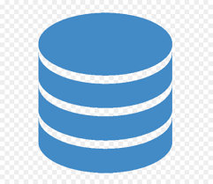
Example monolithic application
eCommerce app
Store front web interface
Customer Accounts
Inventory
Shipping
Back end for mobile app
Monolithic eCommerce app
Application Databases
Mobile app
Mobile API handler
Shipping
Store front
web app
Browser
Accounts
Inventory
An eCommerce Java EE app on Websphere
Notes:
Docker and kubernetes are a MUST for implementing microservices
We will go into more details during the workshop but
Docker solves dependency matrix: uses immutable images that contain dependencies for the app and are shippable across all the different environments
Docker is also a standard that enables orchestration tools like Kubernetes
Kubernetes handles problems of distributed applications
These tools (Docker and Kubernetes) will go a long way to help you build distribute microservice applications
but there are some practices that you will need to implement in the application itself (12-factor)
Its a combination of tools + best practices that will ensure success in your transformation journey

Slide 9
Transformed application
Kubernetes Cluster (OpenShift)
Key technologies
Containers (Docker)
Container orchestration (Kubernetes)
Transformation Advisor
12-Factor Best Practices
CI/CD tools (e.g Jenkins)
An eCommerce microservices app on a Kubernetes cluster
Notes:
Docker and kubernetes are a MUST for implementing microservices
We will go into more details during the workshop but
Docker solves dependency matrix: uses immutable images that contain dependencies for the app and are shippable across all the different environments
Docker is also a standard that enables orchestration tools like Kubernetes
Kubernetes handles problems of distributed applications
These tools (Docker and Kubernetes) will go a long way to help you build distribute microservice applications
but there are some practices that you will need to implement in the application itself (12-factor)
Its a combination of tools + best practices that will ensure success in your transformation journey

Slide 10
Why microservices and cloud native?
Efficient teams
End to end team ownership of relatively small codebases
Teams can innovate faster and fix bugs more quickly
Simplified deployment
Each service is individually changed, tested, and deployed without affecting other services
Time to market is accelerated.
Right tools for the job
Teams can use best of breed technologies, libraries, languages for the job at hand
Leads to faster innovation
Improved application quality
Scalability
Services can be tested more thoroughly in isolation
Better code coverage
Services can be scaled independently at different rates as needed
Leads to better overall performance at lower cost

Slide 11
12 Factor Apps

Slide 12
12 Factor is a methodology for building software

Slide 13
Tenets for a 12 Factor App
Codebase
Dependencies
Config
Backing Services
Build, Release, Run
Processes
Port Binding
Concurrency
Disposability
Dev/Prod Parity
Logs
Admin processes

Slide 14
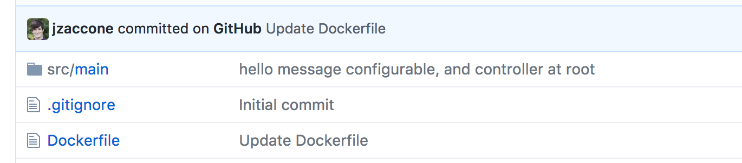
I. Codebase
Code for a single application should be in a single code base
Track running applications back to a single commit
Use Dockerfile Maven, Gradle, or npm to manage external dependencies
Version pinning! Don’t use latest
No changing code in production
Notes:
1 repository that will kick off a build to create 1 build artifact for 1 application
with docker, our build artifact is the docker image
all of our explicit dependencies wrapped into the image
A dockerfile defines the steps to create the build artifact.

Slide 15
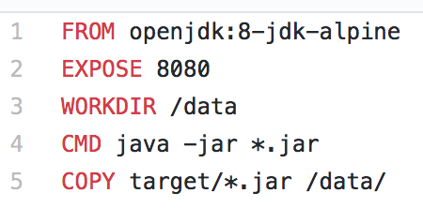
II. Dependencies
Explicitly declare and isolate dependencies. AKA: Remove system dependencies
How?
Step 1: Explicitly declare dependencies (Dockerfile)
Step 2: Isolate dependencies to prevent system dependencies from leaking in (containers)
Notes:
python or ruby, those language specific mechanisms for handling dependencies are encapsulated by Dockerfile
The isolation runtime of the container is exactly the same for each type of application
isolation via namespaces and control groups

Slide 16
III. Config
Store config in the environment (not in the code).
How?
Inject config as environment variables (language agnostic)
ConfigMap in Kubernetes does this ^
Notes:
here injecting password,
- keep secrets out of code
- but can inject the entire url connection string or any configuration that varies between deployments

Slide 17
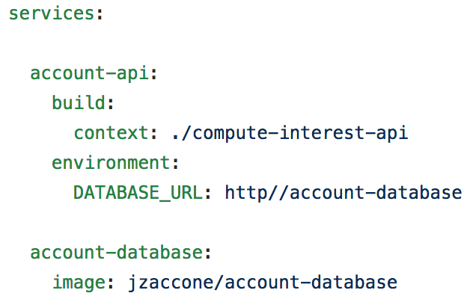
IV. Backing Services
Treat backing resources as attached services. Swap out resources.
How?
Pass in URLs via config (see III.)
K8s built in DNS allows for easy service discovery
Notes:
easily manipulate configuration or DNS to point to another implementation of the backing service
this service discovery by name is also available in orchestration frameworks like kubernetes to easy discovery services either from internal or external applications

Slide 18
V. Build, Release, Run
Strictly separate build and run stages.
Why?
Rollbacks, elastic scaling without a new build
How?
Use Docker images as your handoff between build and run
Tag images with version. Trace back to single commit (see I. Codebase)
Single command rollbacks in Kubernetes
base image
registry
docker build
app code v1.1
v1.1
v1
Notes:
Docker images are your new build artifacts
Build step: create a versioned tagged artifact in which you can release quickly

Slide 19
VI. Process
Execute app as stateless process
Why?
Stateless enables horizontal scaling
How?
Remove sticky sessions
Need state? Store in volume or external data service
Use persistent volumes in Kubernetes for network wide storage
app
app
app
service
Notes:
network storage provides storage for all apps running in the cluster

Slide 20
VII. Port Binding
Export services via port binding. Apps should be self-contained.
Why?
Avoid “Works on my machine”
How?
Web server dependency should be included inside the Docker Image
To expose ports from containers use the —publish flag

Slide 21
VIII. Concurrency
Scale out via the process model. Processes are first-class citizens
Why?
Follow the Unix model for scaling, which is simple and reliable
How?
Scale by creating more processes
Docker: really just a process running in isolation
Kubernetes: Acts as process manager: scales by creating more pods
Don’t put process managers in your containers
microservices app
per process
scaling
microservices app
C
B
C
A
B
C
A
B
C
Notes:
processes are first class citizens

Slide 22
IX. Disposability
Maximize robustness with fast startup and graceful shutdown
Why?
Enables fast elastic scaling, robust production deployments. Recover quickly from failures.
How?
No multi-minute app startups!
Docker enables fast startup: Union file system and image layers
In best practice: Handle SIGTERM in main container process.
Notes:
containers are just a process

Slide 23
X. Dev/Prod Parity
Keep development, staging and production as similar as possible. Minimize time gap, personnel gap and tools gap
How?
Time gap: Docker supports delivering code to production faster by enabling automation and reducing bugs caused by environmental drift.
Personnel gap: Dockerfile is the point of collaboration between devs and ops
Tools gap: Docker makes it very easy to spin up production resources locally by using `docker run ...`
Notes:
causes of environmental drift
security updates to production
intentionally using easier tools for development
environments that are up for many hours have a potential to drift.
good idea to build that environment from scratch to “Reset” it
fast on boarding with new developers
less dependencies on other teams, run the apps your self
don’t muddy up your computers with all these tools

Slide 24
XI. Logs
Treat logs as event streams
How?
Write logs to stdout (Docker does by default)
Centralizes logs using ELK or [your tool stack here]
Don’t write logs to disk!
Don’t retroactively inspect logs! Use ELK to get search, alerts
Don’t throw out logs! Save data and make data driven decisions
Notes:
Remember to get all the benefits of proactive log anaylis

Slide 25
XII. Admin Processes
Run admin/management tasks as one-off processes.
Don’t treat them as special processes
How?
Follow 12-factor for your admin processes (as much as applicable)
Option to collocate in same source code repo if tightly coupled to another app
“Enter” namespaces to run one-off commands via `docker exec …`

